Slide 1
Approximate Computing Techniques for Deep Neural Networks
GROUP MEMBERS: Ananya Garg
Purvi Agarwal
Ruchi Dhamnani
GROUP MENTOR: Dr. Santosh Kumar

Slide 2

Outline:
Introduction
Objective
Motivation
Literature Survey
Proposed Solution
Result
Acknowledgement
References

Slide 3


Introduction
DEEP LEARNING (… moving
beyond shallow machine
learning )

Slide 4
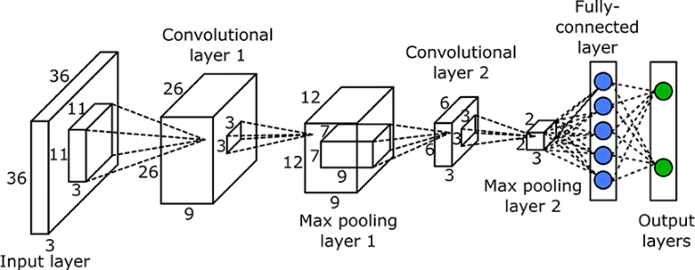
Convolution Neural Network
Life is like a box of neural networks you never know what you gonna get...

Slide 5
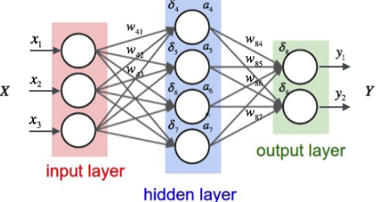
Deep Neural Networks
Troves of data are fed into model.
Produces trading signal.
.
Learns from training data for better predictions.

Slide 6
Motivation...
Why Approximate Computing?
Approximate computing technique is very much useful for improving efficiency (approx double) and reducing energy consumption.
We will be using different adders and multipliers for this purpose and comparing their energy consumption and accuracy. And we have implemented it on Field Programmable Gate Array (FPGA) and ZEDBoard.
In order to become the 1% you must do what the other 99% won’t !!!

Slide 7
 | Title | Link | Year | Advantage | Disadvantage
1) | A Two's Complement Parallel Array Multiplication algorithm | https://ieeexplore.ieee.org/document/1672241 | 1974 | Every partial product bit has a positive coefficient. | Need for the complements of each multiplier and multiplicand
2) | A Flexible Low Power DSP With a Programmable Truncated Multiplier | https://ieeexplore.ieee.org/document/6329993 | 2012 | Conservative power savings of up to 15% | Architecture fabricated on the TSMC 90 nm process area consumption is more
3) | Area efficient multipliers for Digital Signal Processing Application | https://ieeexplore.ieee.org/stamp/stamp.jsp?arnumber=4864 55 | 1996 | Area consumption is reduced to 50% | Due to truncation accuracy is reduced
4) | Design of Reconfigurable Low-Power Pipelined Array Multiplier | https://ieeexplore.ieee.org/document/4064379 | 2006 | Low Power Consumption | Delay overhead
5) | Real-time Fall Detection Algorithm with a Prog. Truncated MAC | https://ieeexplore.ieee.org/iel5/5608545/5625939/05626244.pdf | 2010 | 23% power savings without any accuracy loss. | Truncation of low bits of columns result in robust gap values

Slide 8
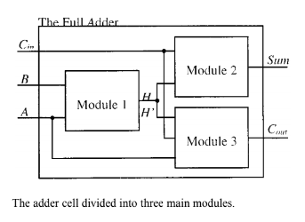
Low power 1-Bit CMOS Full Adder Cells
Approximate Computing Techniques:
It exhibits different power consumption, speed, area, and driving capability are analysed.
We break the large circuit in smaller modules. For each module we try to minimise the dynamic and static power consumption.
A

Slide 9
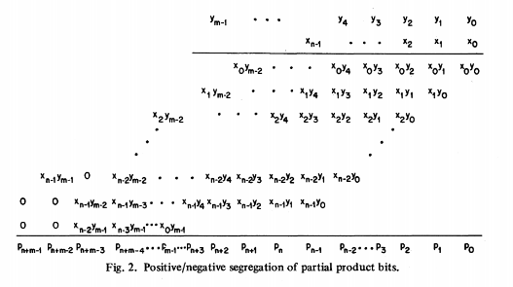
Approximate Multiplier
A Two's Complement Parallel Array Multiplication Algorithm:
In this method the signs of all the partial product bits are positive.
The product is formed by adding the first n - 2 partial product rows and subtracting the last two rows. Instead of subtracting the partial products that have negative signs, the negation of the partial products can be added.

Slide 10
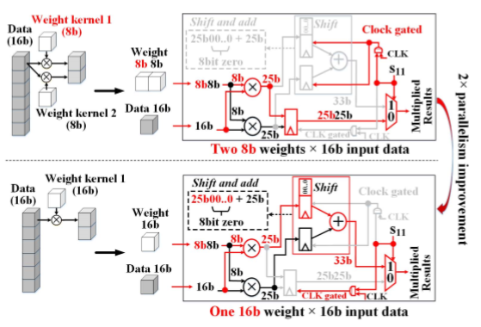
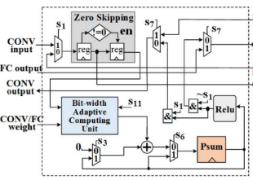
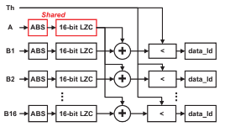
BIT WIDTH ADAPTIVE COMPUTING UNIT
Processing element
APPROXIMATION UNIT

Slide 11

Proposed Method:
Signed Magnitude multiplication:
It is done using AND gate which is implemented by MUX and after that half adders are used for addition. And after that XOR gate is used for sign computation.
We have designed 2*2, 4*4, 8*8, 16*16 multiplier and 16*16 Multiplier and Accumulator and implemented them on ZEDBoard. The result are as follows:

Slide 12
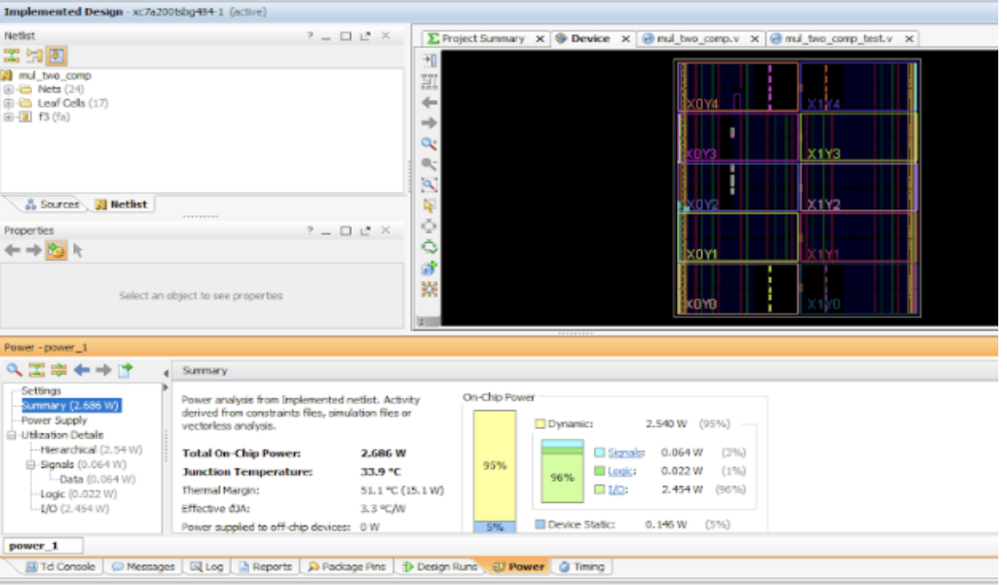
Power Consumption of Signed Multiplication

Slide 13
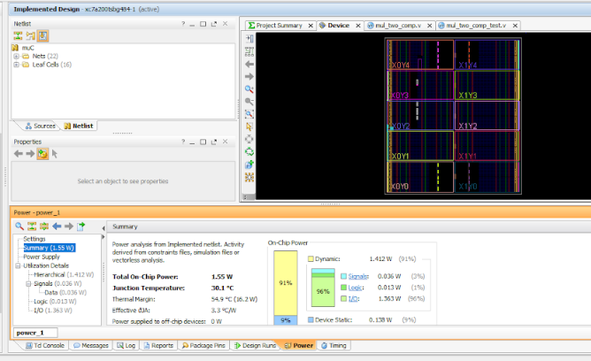
Power Consumption of Signed Multiplication after Near Zero approximation

Slide 14
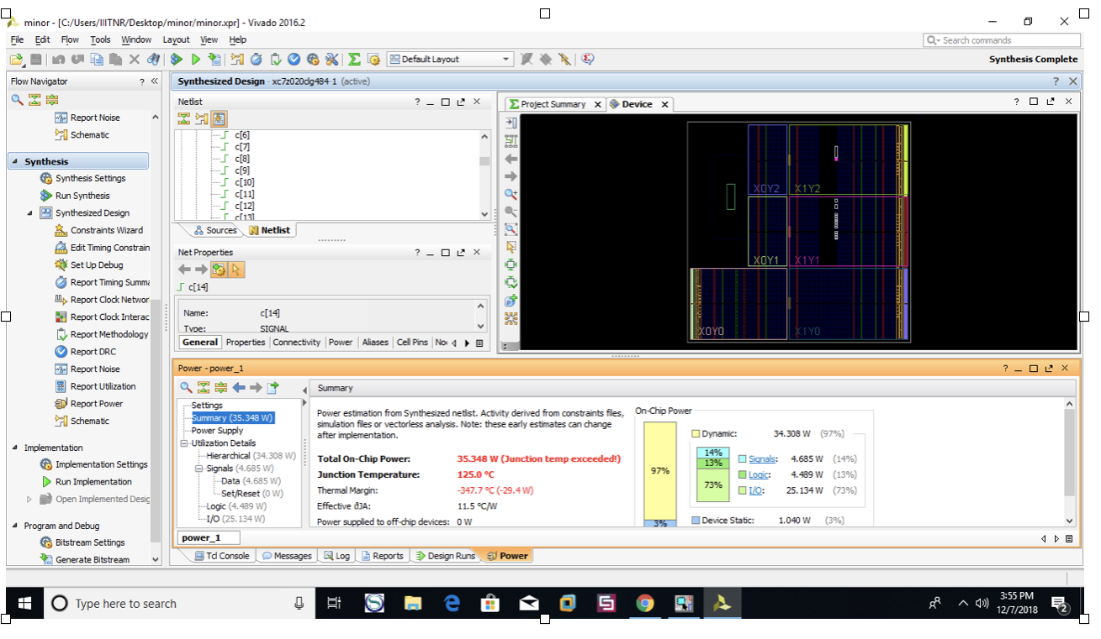
Power Consumption of Multiplier and Accumulator

Slide 15
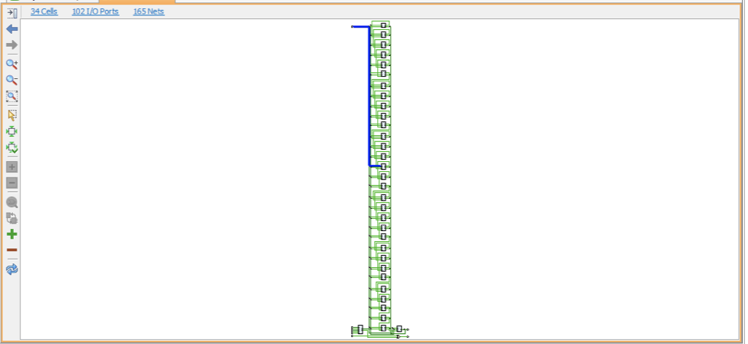
Schematic of MAC:

Slide 16
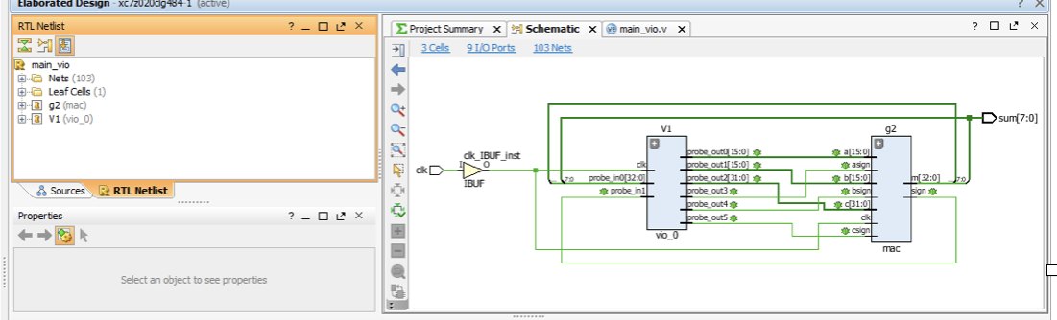
RTL Analysis of MAC

Slide 17
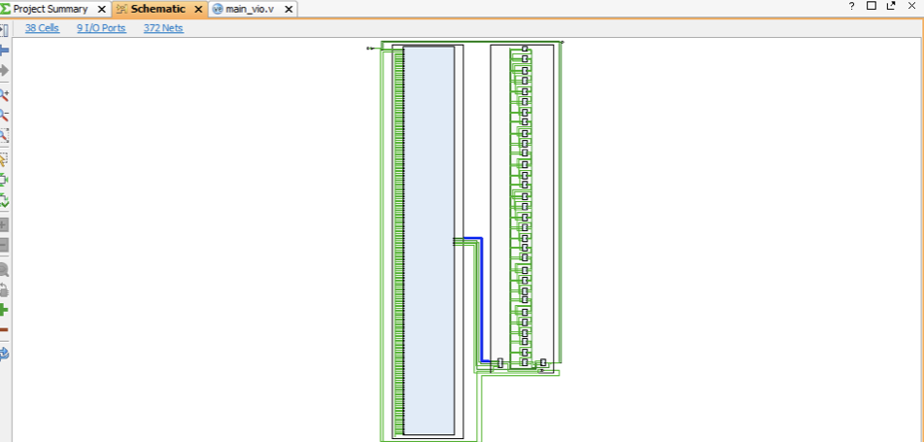
Schematic of MAC after Virtual Input and Output

Slide 18
Power Comparison of Different Multipliers
SNo. | Power comparison of different multipliers
 | Multipliers | Power Consumption
1.) | 2x2 signed | 1.59W
2.) | 2x2 using two’s complement | 2.868W
3.) | 4x4 signed | 6.064W
4.) | 8x8 signed | 11.45W
5.) | 16x16 signed | 30.479W
6.) | 16x1 signed | 4.612W
7.) | 16x2 signed | 10.79W
8.) | 16x4 signed | 18.28W

Slide 19
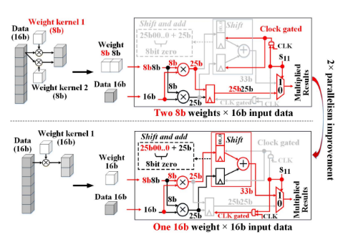
Bit Width Adaptive Computing Unit
When the bit-width of weight is larger than 8-bit, these two multipliers are combined as one 16 × 16-bit multiplier.
The result of high 25-bit part is shifted by 8-bit with zero filling. Then it adds with the low 25-bit part. By setting S11 as 1, the result is output. Compared to the multipliers in
our design are all utilized in either 8-bit mode or 16-bit mode.
Therefore, our design has higher resource utilization.

Slide 20
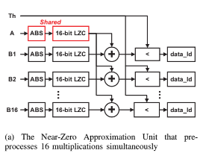
Low-power accelerator for processing Deep
Neural Networks
The power reduction is realized by avoiding multiplications of near-zero valued data.The near-zero approximation are proposed to predict and skip the near-zero multiplications under certain thresholds.
This design achieves 1.92X and 1.51X further reduction of the total multiplications with negligible loss of accuracy.
The accelerator, designed using it consumes less energy approximately 717 times less energy and is comparatively 4 times faster.

Slide 21
Acknowledgement
The success and outcome of this project till now required a lot of guidance and assistance from many people and we are extremely privileged to have got this all along during our project.
We all respect and thank Dr. Ramesh Vaddi (Senior Research Fellow National University of Singapore) for providing us constant support and mentoring for this project work and giving us all this wonderful opportunity to work with him.
We are shaped by our thoughts; we become what we think !

Slide 22
References:
[1] C.R. Baugh and B.A. Wooley, “A Two’s Complement Parallel Array Multiplication Algorithm,” IEEE Trans. Computers, vol. 22, no. 12, pp. 1045-1047, Dec. 1973.
[2] M.J. Schulte and E.E. Swartzlander Jr., “Truncated Multiplication with Correction Constant,” Proc. Workshop Very Large Scale Integration (VLSI) Systems Signal Processing, VI, pp.
[3]Tarun Vatwani, Arko Dutt, Debjyoti Bhatacharjee , Anupam Chattopadhyay, “Floating Point Multiplication Mapping on ReRAM based In memory Computing Architecture,” 2018 31st International Conference on VLSI Design and 2018 17th International Conference on Embedded Systems (VLSID).
[4] Jiun-ping Wang ; Shiann-rong Kuang ; Yuan-chih Chuang “Design of Reconfigurable Low-Power Pipelined Array Multiplier” 2006 International Conference on Communications, Circuits and Systems.

Slide 23


